Slide 1

VoiceCoach
Eli ben Shimol, Yonatan shnits, Ziv cohen gvura, Nave avraham

Slide 2

Risk assessment and proof of concept
Technical Compatibility -> compatibility tests
User Adaptation -> Conduct user testing
Data Security and Privacy - > Implement verification and secure DB
Feedback and visualization -> testing of the feedback algorithms
Real-time Voice Sampling -> Implement optimizations based on performance testing results
Understanding Hebrew -> Usage of built in tools

Slide 3
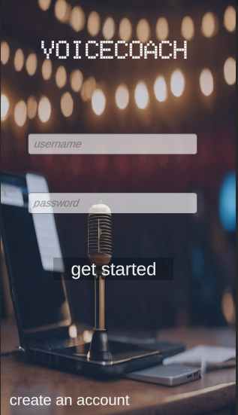
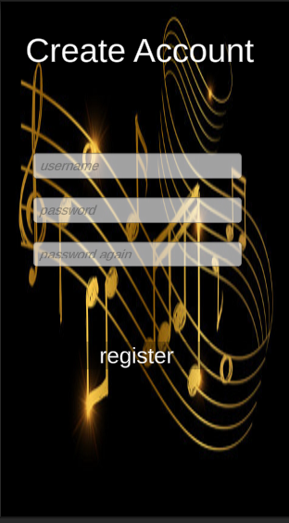

User Adaptation
Testing:
* user study
* UI testing

Slide 4




Data Security and Privacy

Slide 5
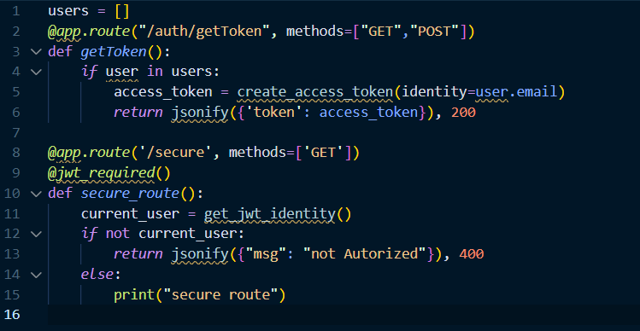

Slide 6
Security tests
sending msg w\o token - unauthenticated
01
request for someone else data - unauthorized
02
flooding system open routes
03

Slide 7


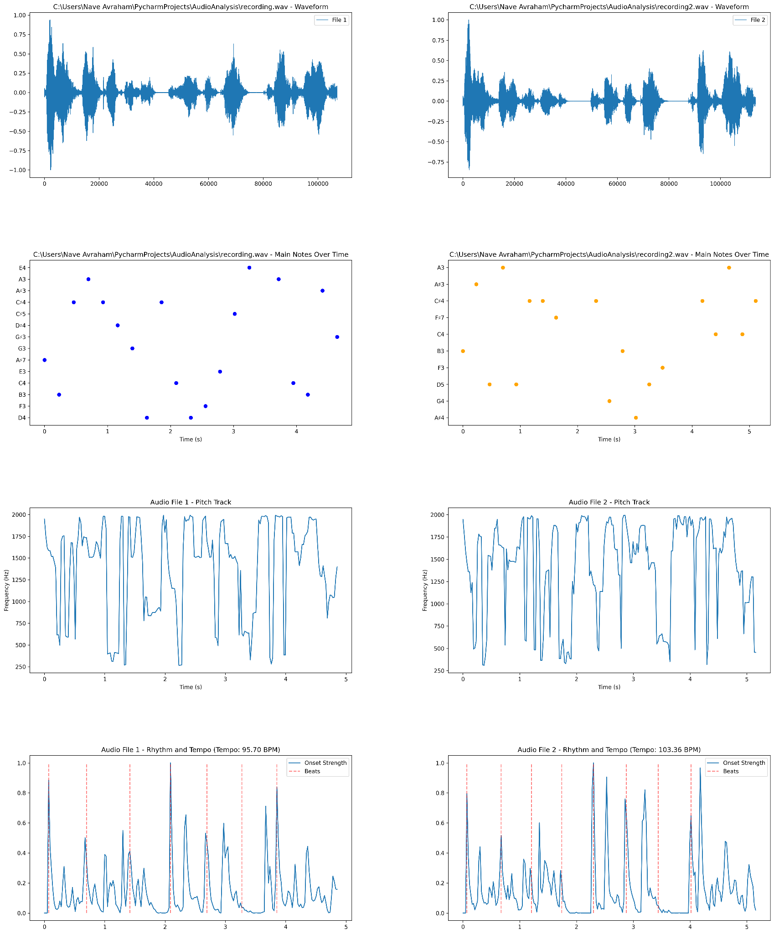
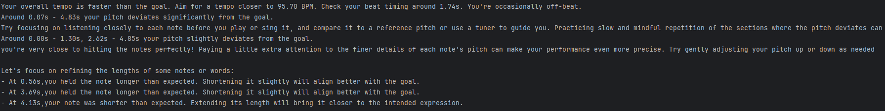
Feedback and visualization
Extract (key features)
Analyze
Generate feedback and visualization

Slide 8
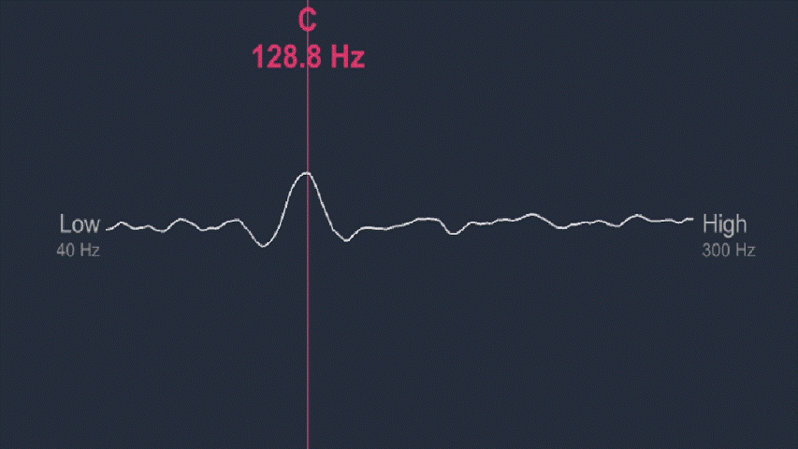
Real-time Voice Sampling

Slide 9

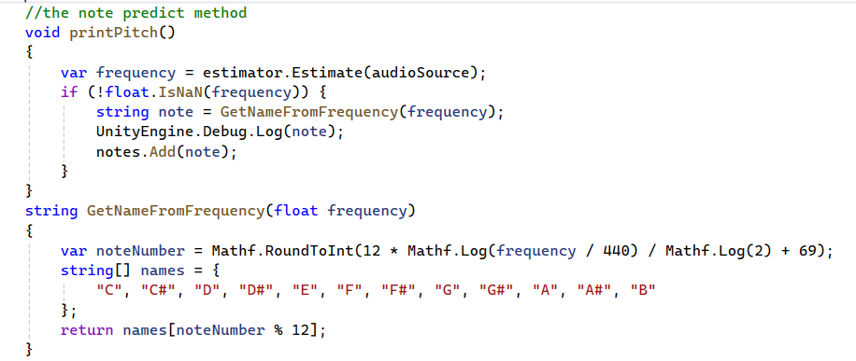
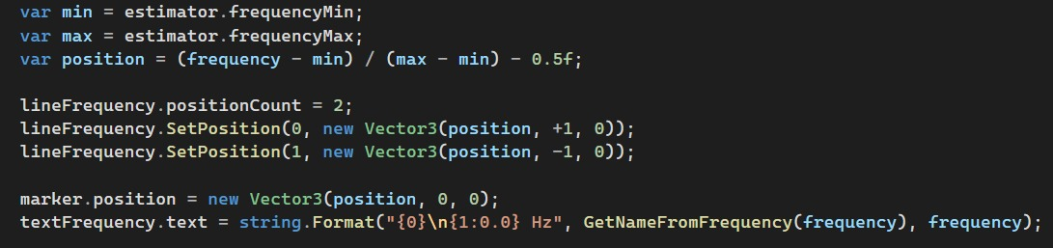
Real-time Voice Sampling
Testing:
* creating environment
* checking for suitable thresholds
* testing multiple voice samples

Slide 10



Visualization options

Slide 11

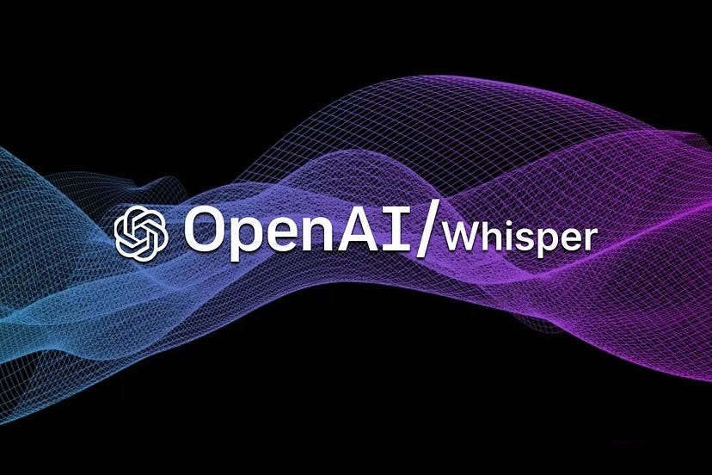
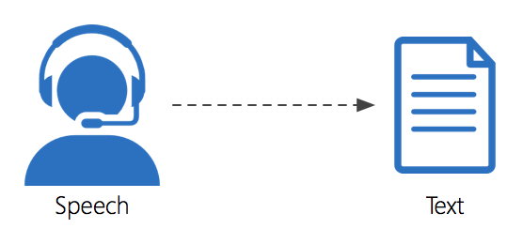
Understanding Hebrew

Slide 12
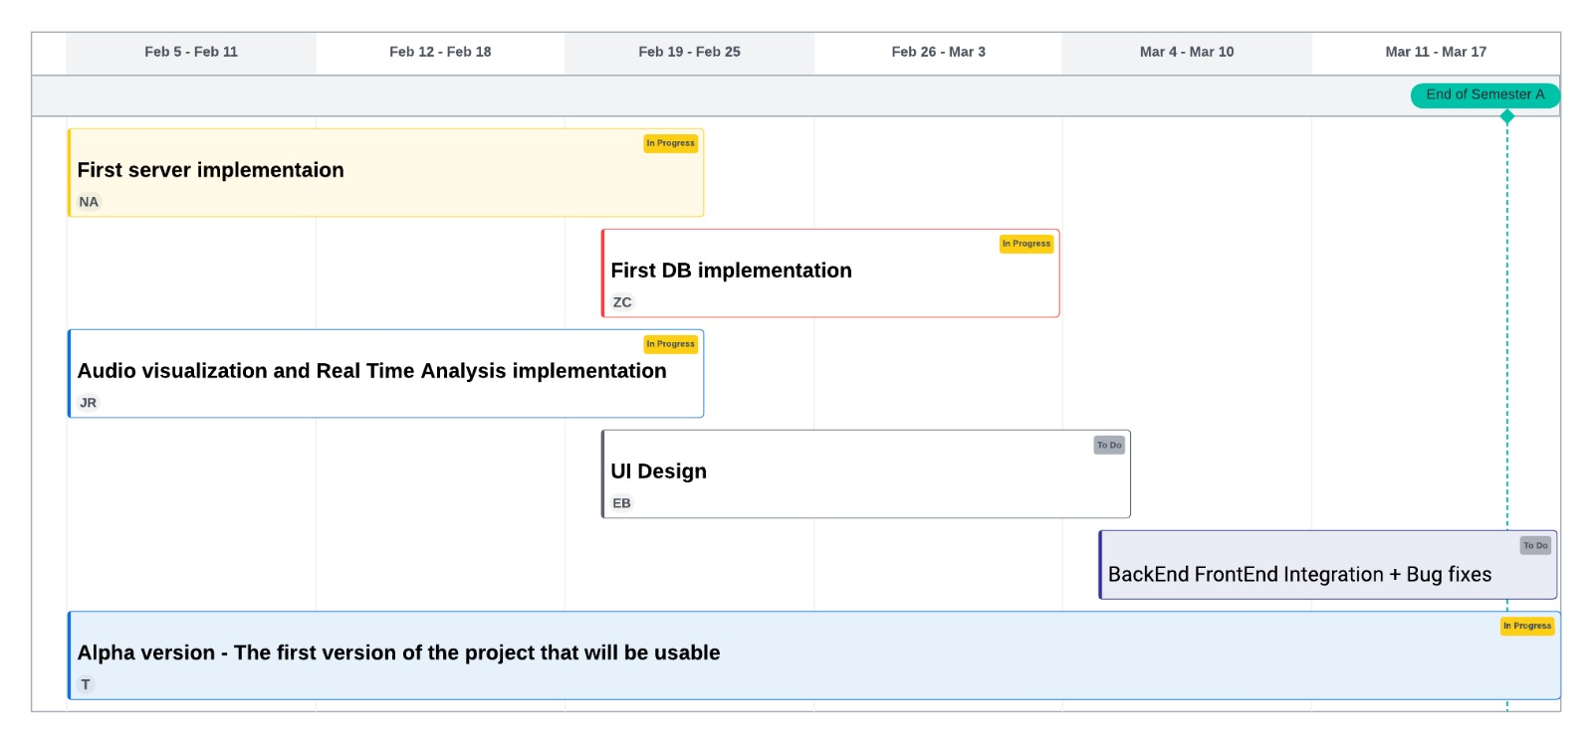
Gnatt

